Slide 1
Greatness in the Kingdom
Kingdom Character
(Matt 5:1-12)
Kingdom Calling
(Matt 5:13-16)
Kingdom Conduct
(Matt 5:17-7:27)

Slide 2
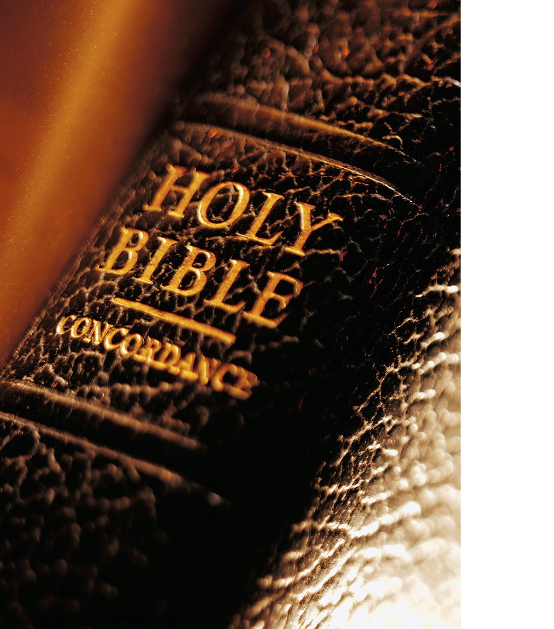
Matthew 5:21-26 ²¹ “You have heard that our ancestors were told, ‘You must not murder. If you commit murder, you are subject to judgment.’ ²² But I say, if you are even angry with someone, you are subject to judgment! If you call someone an idiot, you are in danger of being brought before the court. And if you curse someone, you are in danger of the fires of hell.

Slide 3
Matthew 5:21-26 ²³ “So if you are presenting a sacrifice at the altar in the Temple and you suddenly remember that someone has something against you, ²⁴ leave your sacrifice there at the altar. Go and be reconciled to that person. Then come and offer your sacrifice to God.

Slide 4
Matthew 5:21-26 ²⁵ “When you are on the way to court with your adversary, settle your differences quickly. Otherwise, your accuser may hand you over to the judge, who will hand you over to an officer, and you will be thrown into prison. ²⁶ And if that happens, you surely won’t be free again until you have paid the last penny.

Slide 5
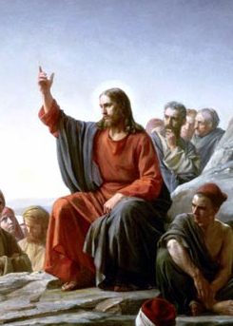
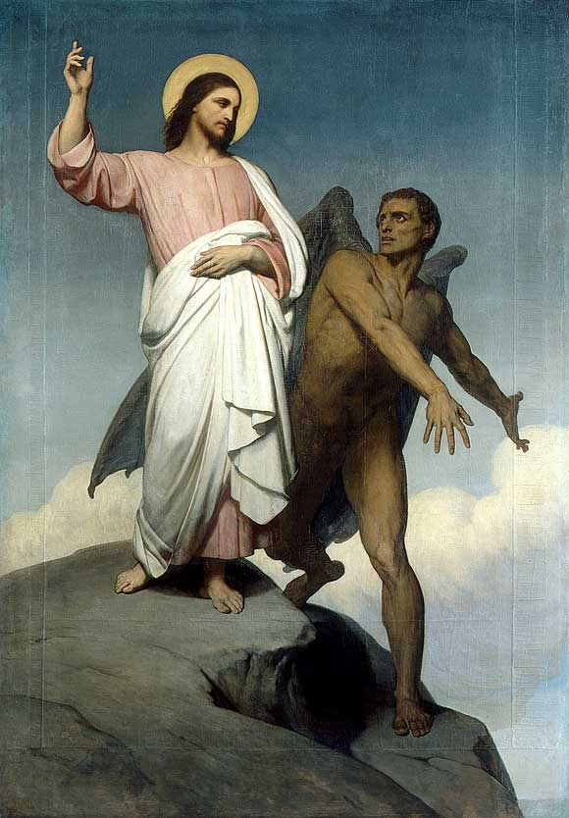
Great Kingdom Relationships
“You have heard that it was said”
“It is written”
(gegraptai)

Slide 6
Great Kingdom Relationships
You shall not murder
(Exodus 20:13)
If anyone takes a human life, that person’s life will also be taken by human hands. For God made human beings in His own image.
(Genesis 9:6)

Slide 7
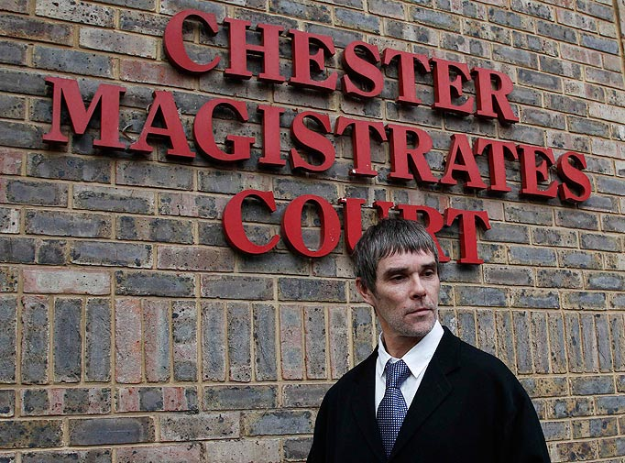
Great Kingdom Relationships
If you commit murder, you are subject to “the judgment”.
(Matthew 5:21)
“The judgment” was the lowest court

Slide 8
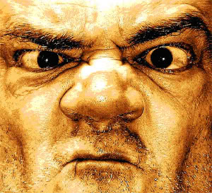
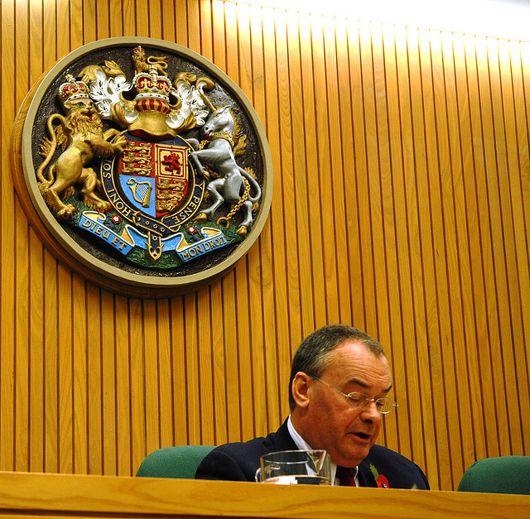
Great Kingdom Relationships
“thumos”
angry outburst
“orge”
seething anger
“if you are even angry with someone” (Matthew 5:22)
“you are subject to the judgment” (Matthew 5:22)

Slide 9
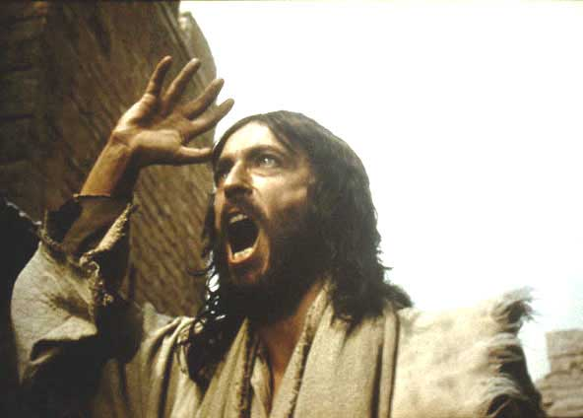
Great Kingdom Relationships
(Jesus) looked around at them angrily and was deeply saddened by their hard hearts.
(Mark 3:5)

Slide 10
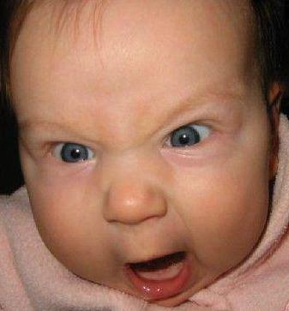
Great Kingdom Relationships
Put aside anger, wrath …
(Colossians 3:8)
Be angry, and yet do not sin.
(Ephesians 4:26)
Be slow to anger
(James 1:19)
Man’s anger does not achieve God’s righteousness
(James 1:20)
Anger gives the devil a foothold (Ephesians 4:27)
Godly anger hates sin
Godly anger loves sinners

Slide 11
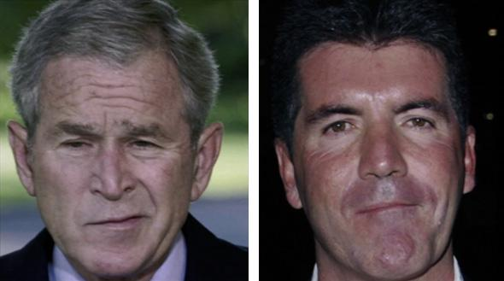
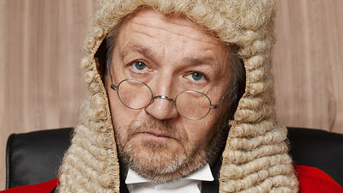
Great Kingdom Relationships
“you are in danger of being brought before the court”
(Matthew 5:22)
“if you call someone an idiot”
(Matthew 5:22)
“Raca” is Aramaic term of contempt

Slide 12
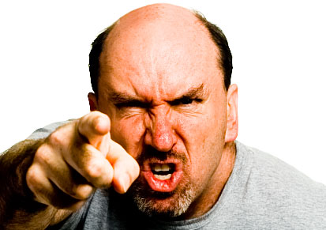
Great Kingdom Relationships
“moros” is a moral fool
“in danger of the
fires of hell”
(Matthew 5:22)
“whoever says “You fool”
(Matthew 5:22)

Slide 13
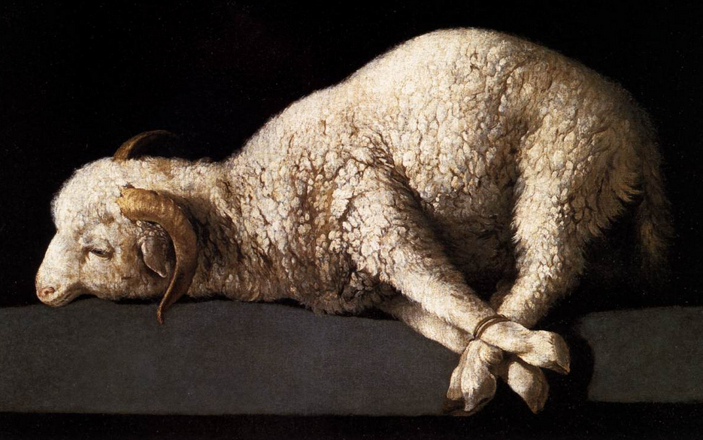
Great Kingdom Relationships
offering your gift at the altar
(Matthew 5:23)

Slide 14
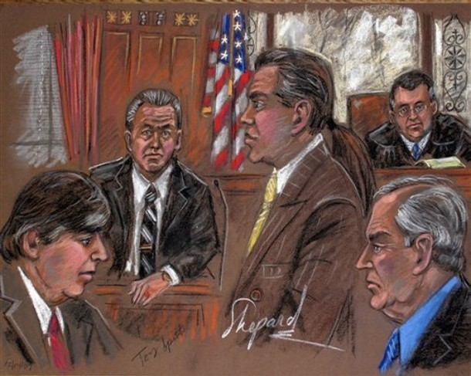
Great Kingdom Relationships
on your way to court
(Matthew 5:24)

Slide 15
Great Kingdom Relationships
It is the heart that matters most
God sees not as man sees.
(1 Samuel 16:7)

Slide 16
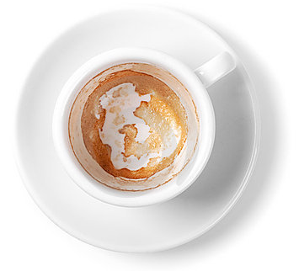
Great Kingdom Relationships
so careful to clean the outside of the cup
but inside you are filthy
- full of self-indulgence!
Woe to you Scribes and Pharisees!
(Matthew 23:25)

Slide 17
Great Kingdom Relationships
Scorning others deeply offends God!
God made human beings in His own image.
(Genesis 1:26-27, 6:9)

Slide 18
Great Kingdom Relationships
Relationships impact our worship
Fellowship with God, fellowship with each other.
(1 John 1:6-7, 2:9)

Slide 19
Great Kingdom Relationships
Reconciliation moves towards
If someone has something against you, go to him
If a believer sins against you, go to him
(Matthew 5:23, 18:15)

Slide 20
Great Kingdom Relationships
Reconciliation is urgent
Settle your differences quickly!
Don’t let the sun go down while you are angry.
(Matthew 5:24, Ephesians 4:26)

